Slide 1
Evaluating Alzheimer's Detection Comparing Use of Convolutional Neural Networks, Transfer Learning and Binary Classification.
Dillon Fleharty

Slide 2
Classifying Alzheimer's Disease
Introduction
Exploratory Data Analysis
Classifying Multiple Classes with Convolutional Neural Network
Classifying Multiple Classes with Pre-Trained Model
Binary Classification with Convolutional Neural Network
Results

Slide 3
Introduction
Alzheimer's disease (AD) effects more than 55 million individuals world-wide.
No current cure, early detection is critical
This research aims to enhance early diagnostics by using Convolutional Neural Networks (CNNs) analyzing MRI scans
Dataset used is from Open Access Series of Imaging (OASIS-1)
80,000 cross-sectional MRI scans from 416 subjects aged 18-96, including 100 elderly subjects diagnosed with Alzheimer's
Three CNNs:
Model 1: Classifies subjects into four categories: Non-Demented, Very Mild, Mild, and Moderate
Model 2: Employs transfer learning techniques using a pre-trained 'EfficientNetB0' base, supplemented with a custom layer
Model 3: Using binary classification for either Non-Demented or Demented

Slide 4
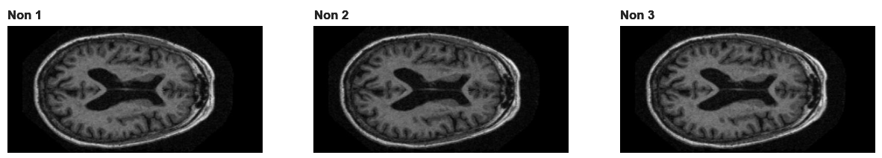
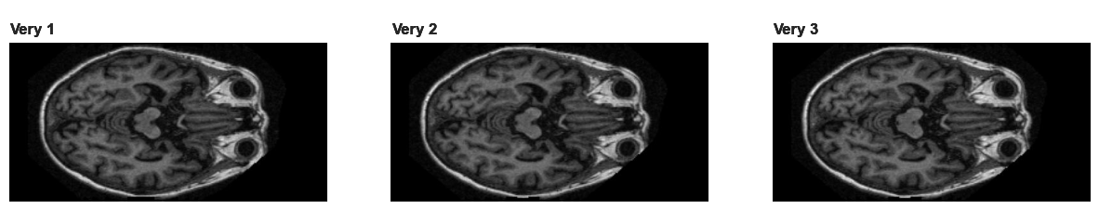
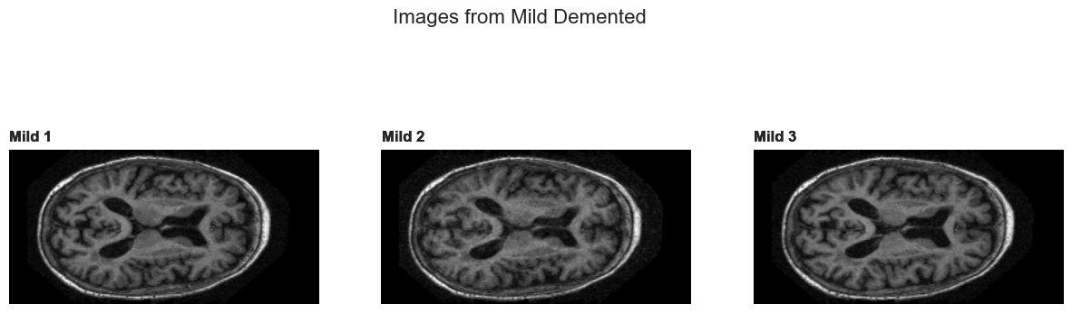

Slide 5
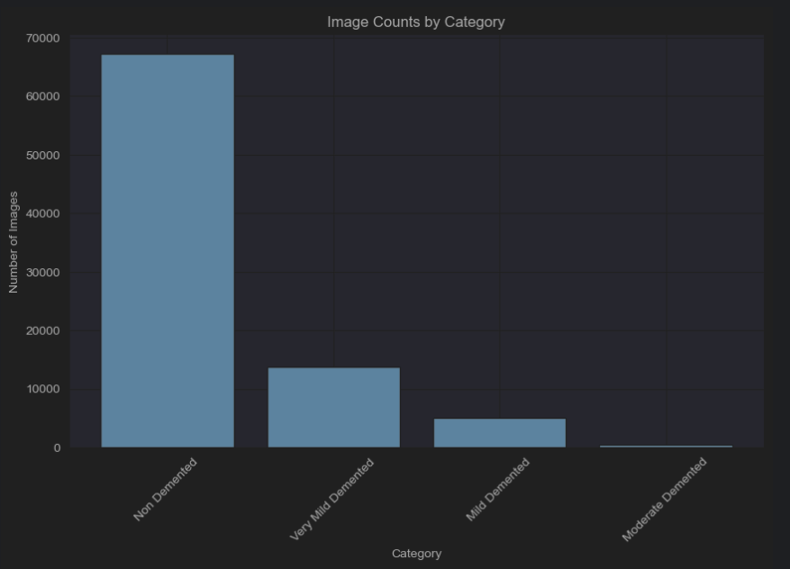
Dataset and Statistics
Non-Demented: 67,222
Very Mild: 13,725
Mild: 5002
Moderate: 488

Slide 6
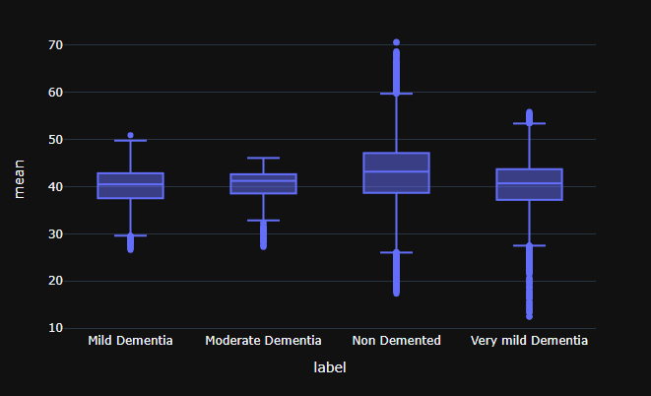
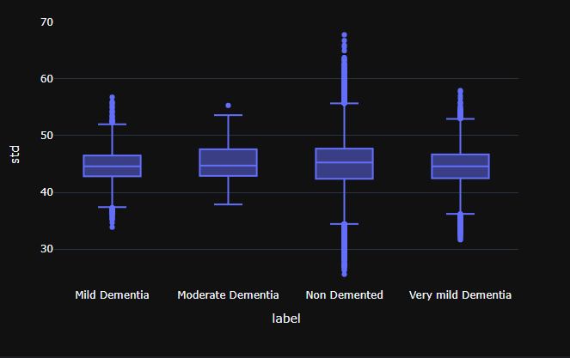
Image Stats

Slide 7
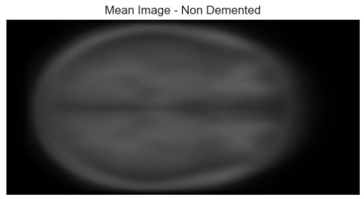
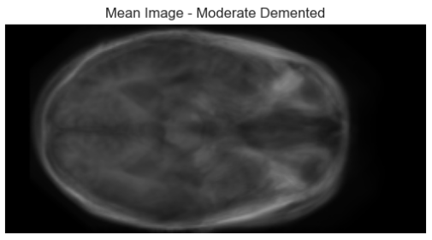
Display of Mean Pixel Values for Non-Demented / Demented

Slide 8
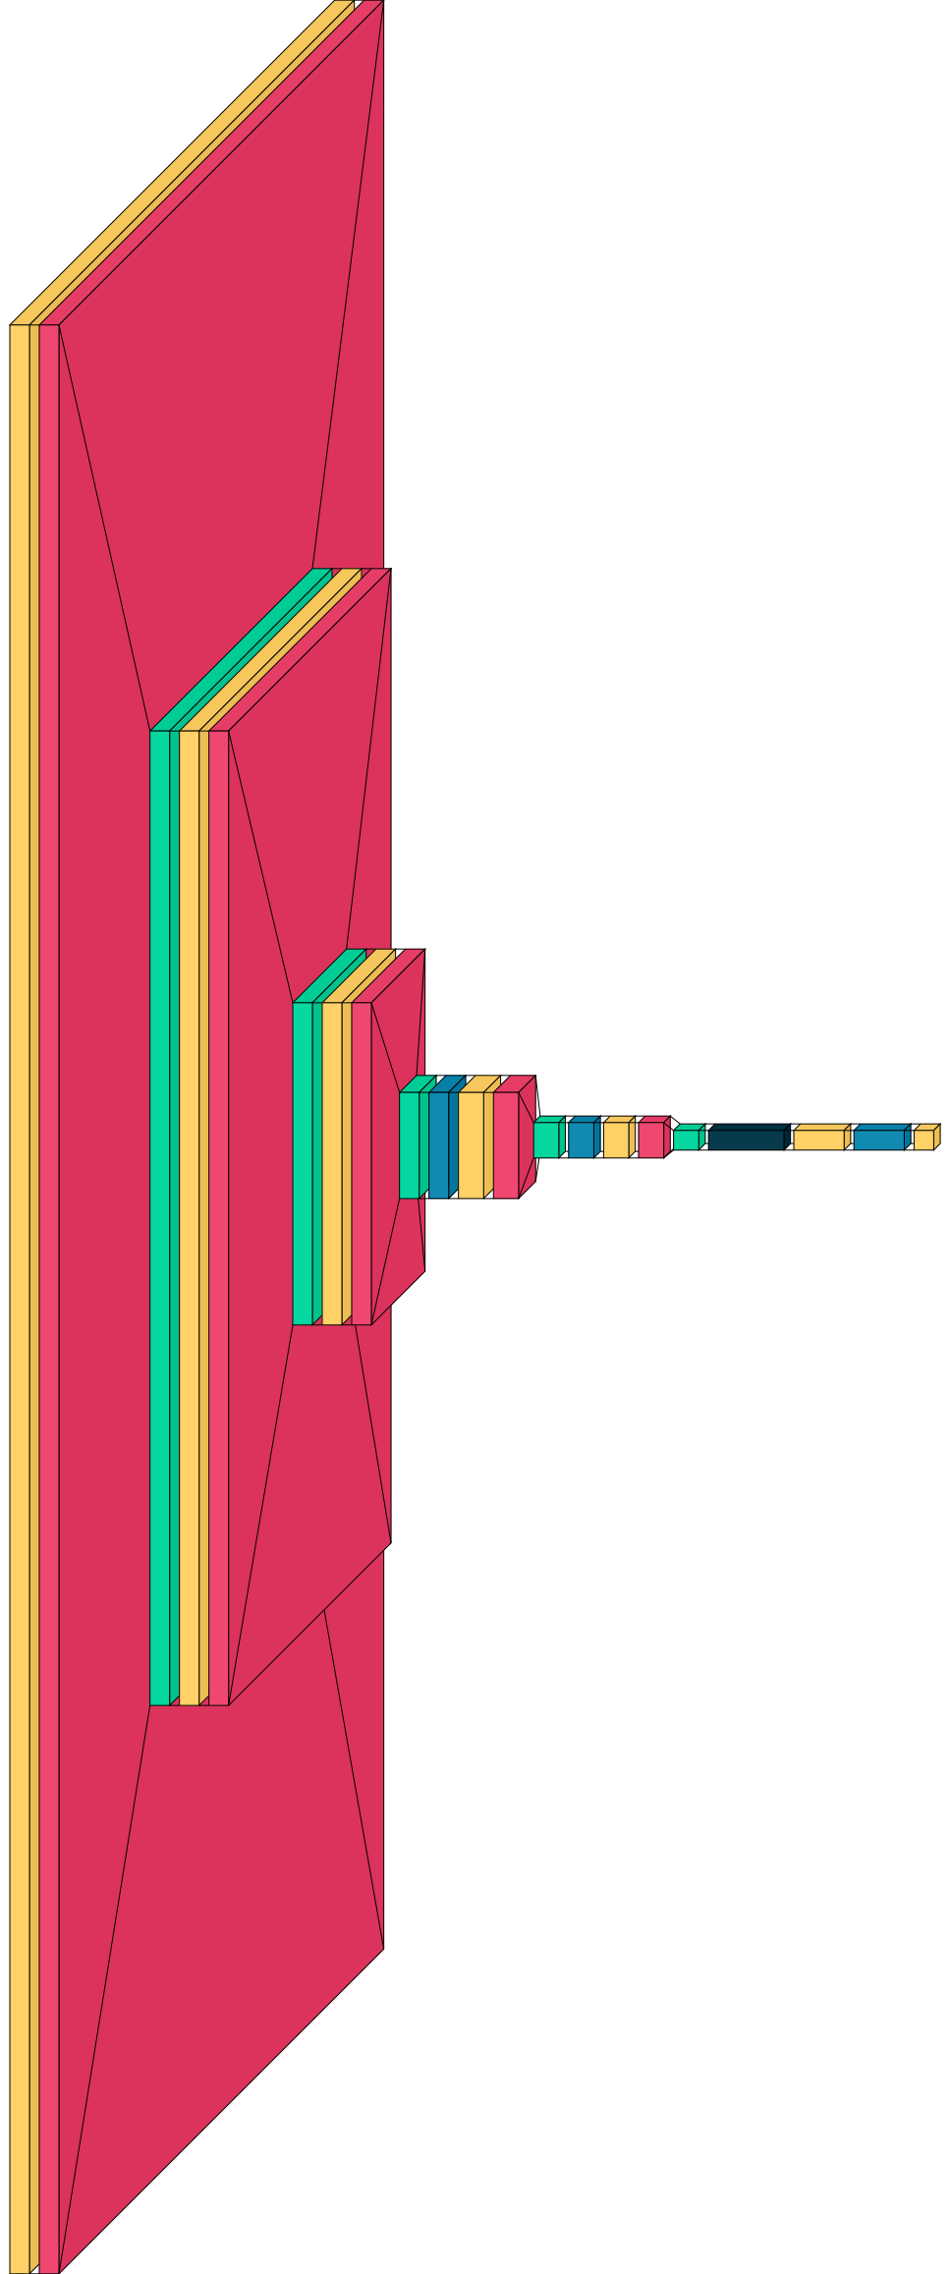
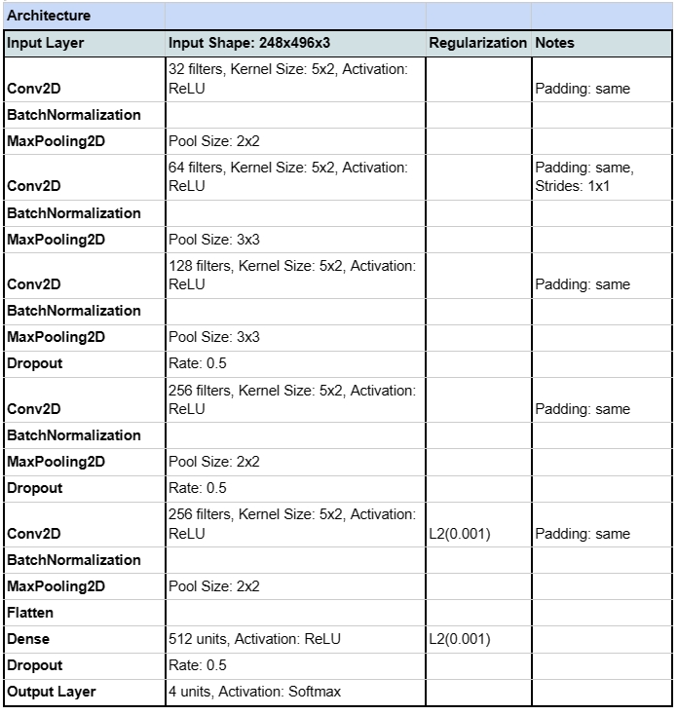
Model 1 Architecture

Slide 9
Model 1
Model Architecture: Sequential CNN
Training Images:
Non-Demented: 4000
Very Mild: 2000
Mild: 4001
Moderate: 390
Test Images:
Non-Demented: 1000
Very Mild: 248
Mild: 496
Moderate: 3
Optimization Techniques:
Adam optimizer with .0001 learning rate
Learning rate scheduler with linear decay
L2 Regularization
Kernal size variations
Strategy:
Data augmentation on MRI scans to prevent overfitting,
one-hot encoding for label categorization
20% validation split

Slide 10
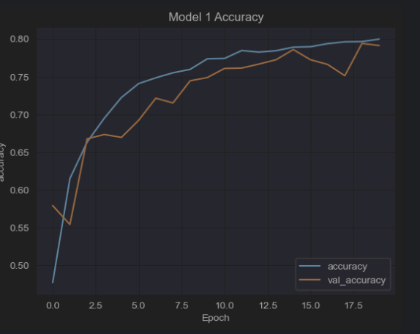
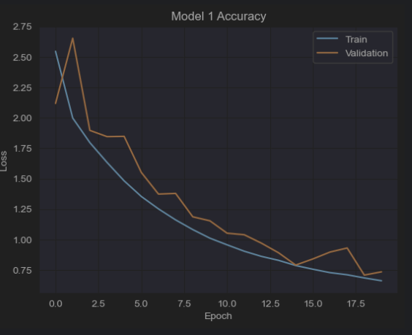
Model 1 Training and Test Results
Test Accuracy: 79.42%
Precision: 0.6569
Recall: 0.7942
F1 Score: 0.7163

Slide 11
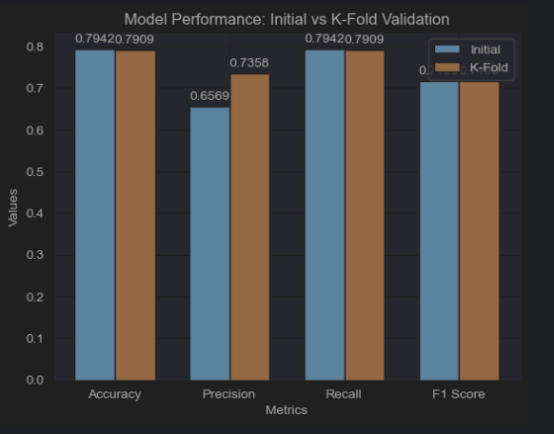
Model 1 K-Fold Cross Validation Results
K-fold validation is a statistical technique that divides a dataset into multiple subsets, using each in turn for testing a model trained on the remaining data to ensure a robust and generalized evaluation of its performance.
Average Test Accuracy: 0.7660
Average Precision: 0.7238
Average Recall: 0.7660
Average F1 Score: 0.7028

Slide 12
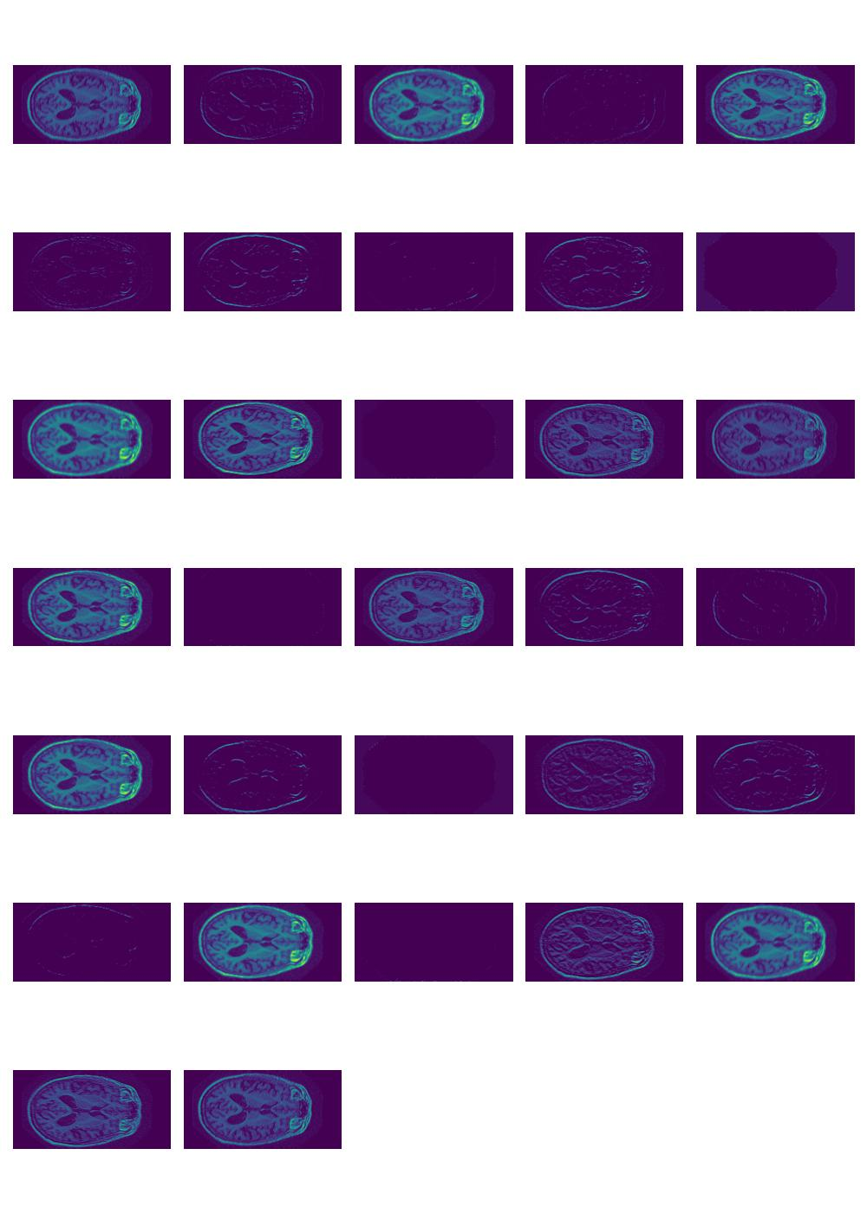
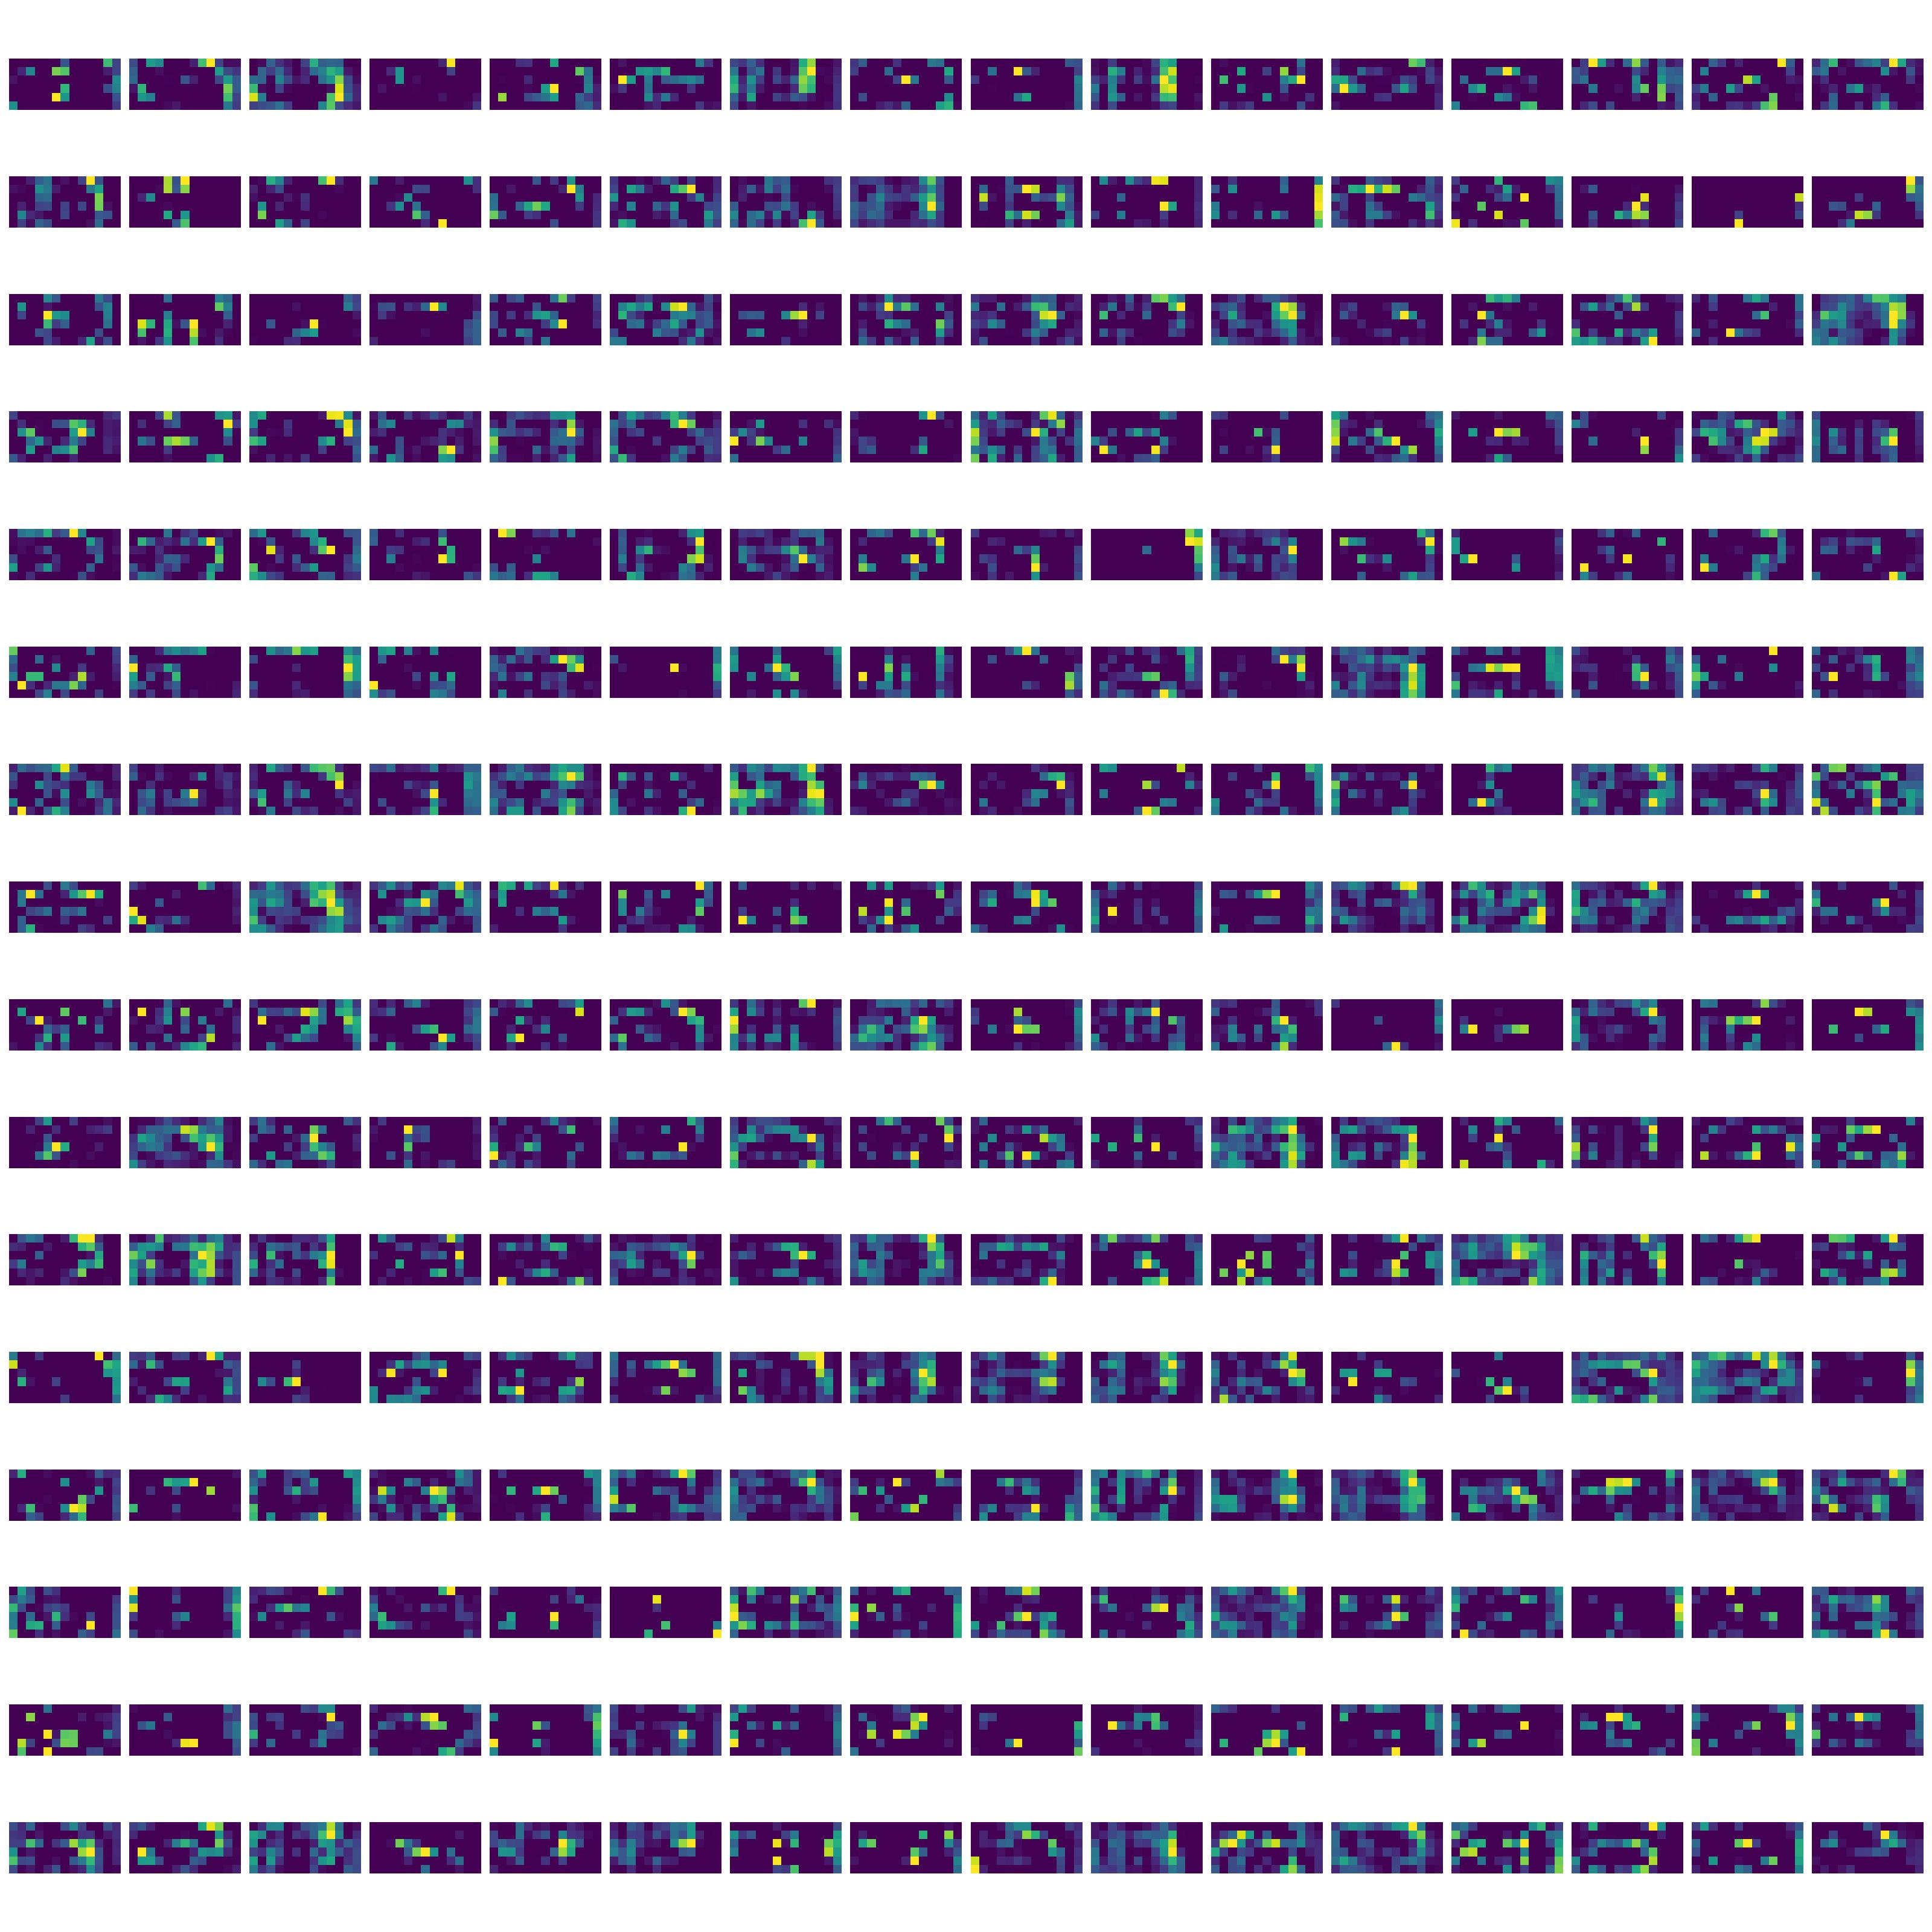
Model 1 Feature Maps
Highlight Key Visual Cues to reveal textures, edges, pattens the network detect at different layers.
Understanding Model Focus by examining the feature maps it helps to understand the models decision-making process and to ensure it aligns as expected
Progressive Complexity in feature maps increases with each layer, moving from simple edges in early layers to more abstract features in deeper layers, indicating the hierarchical nature of feature extraction in CNNs.

Slide 13
Model 1 Feature Maps

Slide 14
Model 1 Feature Maps

Slide 15
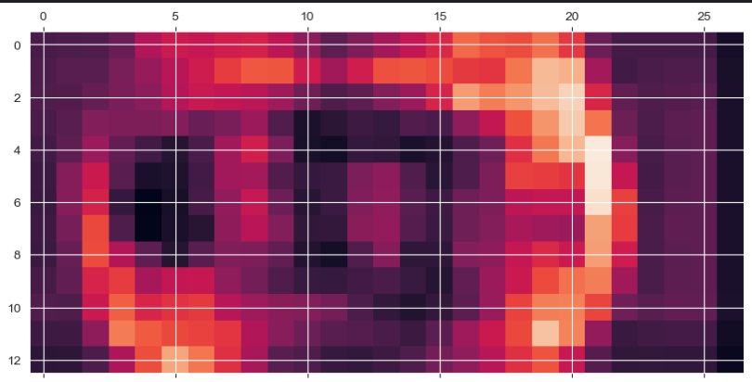
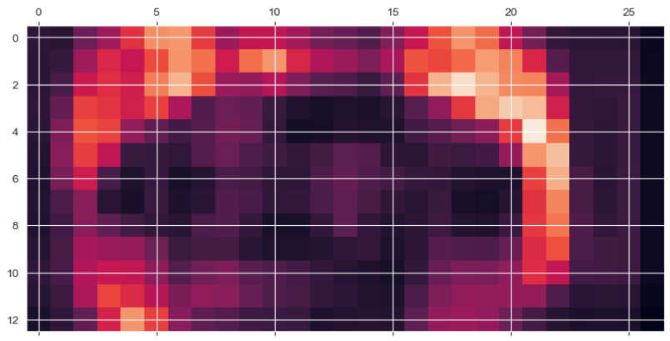
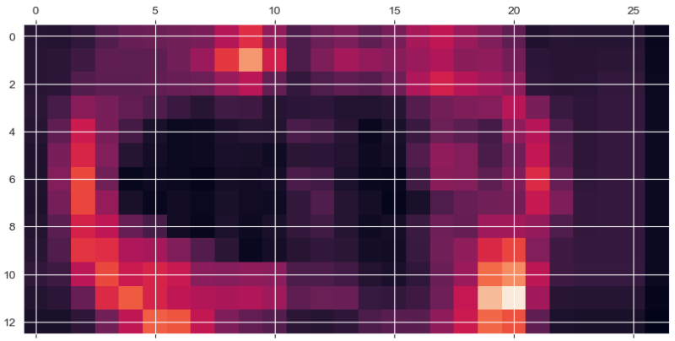
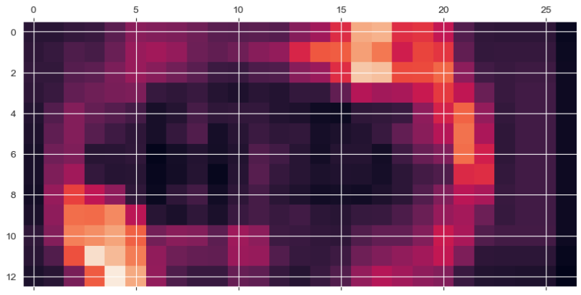
Model 1 Heat Map
Non-Demented
Mild
Very Mild
Moderate

Slide 16
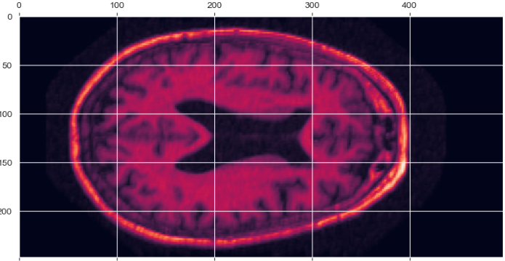
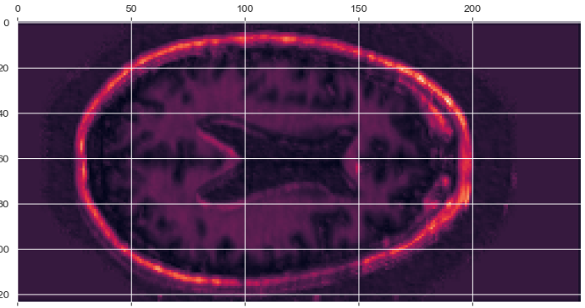
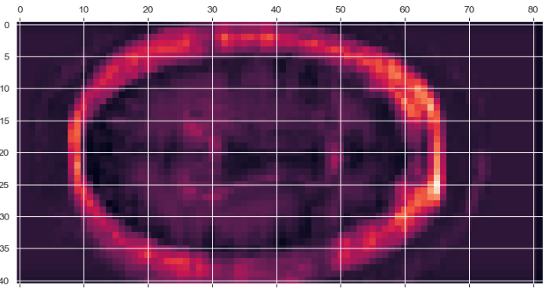
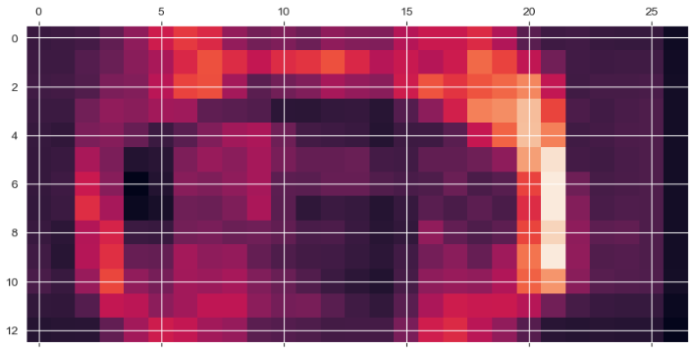
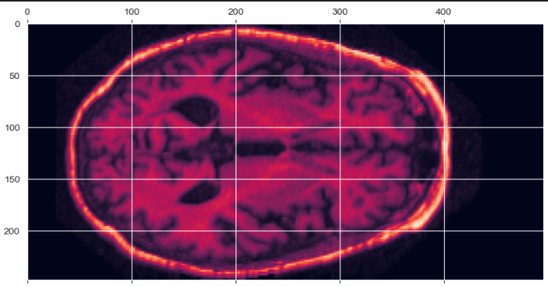
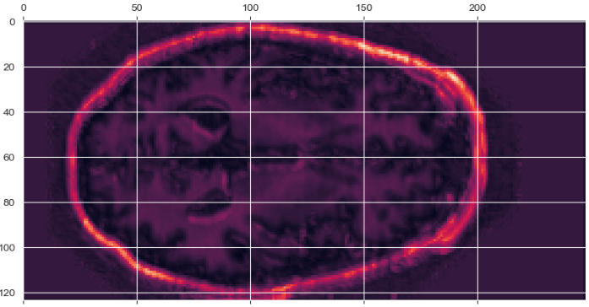
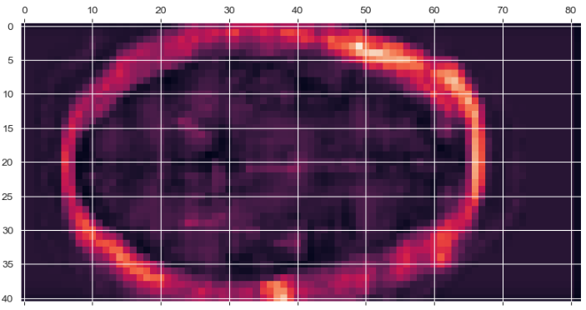
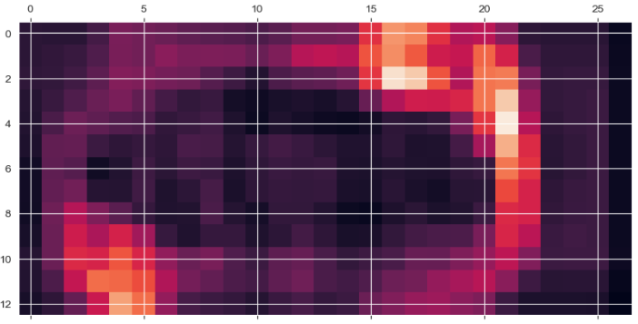
Model 1 Heatmap Layers 1 to 4
Non-Demented
Moderate Demented

Slide 17
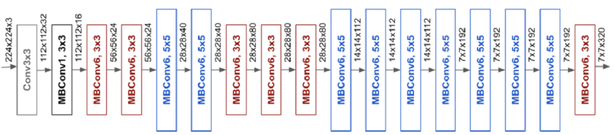
Model 2 EfficientNetB0 Architecture
Developed by: Minxing Tan and Quoc V. Le at Google Research
Scalable Architecture: EfficientNetB0 is a convolutional neural network that uses a compound scaling method to uniformly scale the depth, width, and resolution of the network.
Mobile Inverted Bottleneck Convolution (MBConv): It employs MBConv blocks, an efficient variant of convolutional layers that use depthwise separable convolutions to reduce the number of parameters and computational cost.
ImageNet Dataset: Original model was trained on the ImageNet dataset (+14 million images with 1000 different classes)
Dataset Subset: 1.2 million images.
The Mobile Inverted Bottleneck Convolution (MBConv) utilizes inverted residuals and linear bottlenecks, combining depthwise separable convolutions with shortcut connections

Slide 18
Model 2 EfficientNetB0 Parameters
Model Architecture: Sequential CNN
Training Images:
Non-Demented: 4000
Very Mild: 2000
Mild: 4001
Moderate: 390
Test Images:
Non-Demented: 2599
Very Mild: 248
Mild: 496
Moderate: 3
Optimization Techniques:
Adam optimizer
Loss Function: Categorical Cross Entropy
Processing
one-hot encoding for label categorization
20% validation split

Slide 19
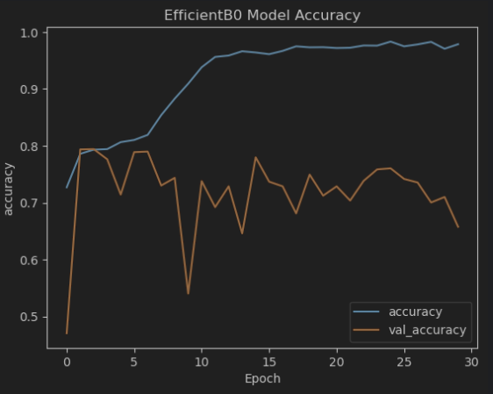
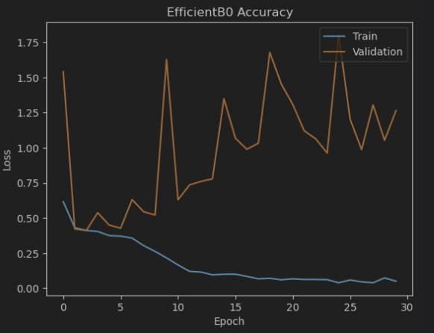
Model 2 EfficientNetB0 Training Results
Test Accuracy: 68.99
Precision: 0.7174
Recall: 0.6899
F1 Score: 0.7021

Slide 20
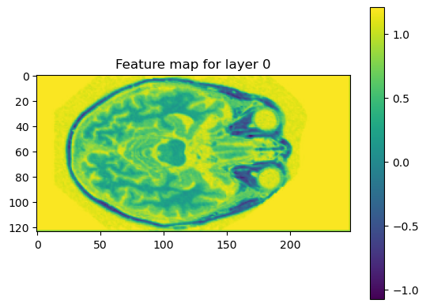
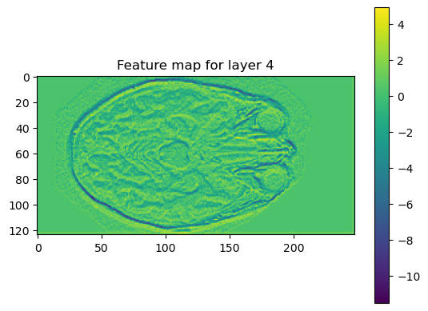
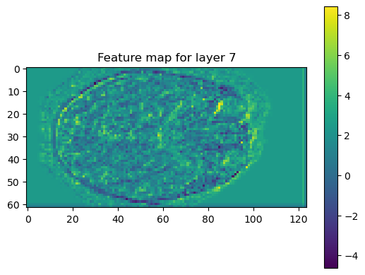
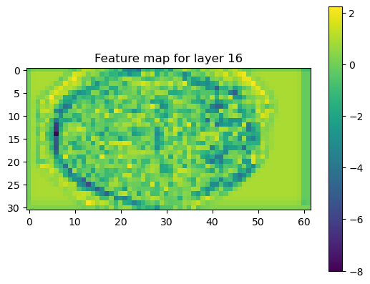
Model 1 Feature Maps
Highlight Key Visual Cues to reveal textures, edges, pattens the network detect at different layers.
Understanding Model Focus by examining the feature maps it helps to understand the models decision-making process and to ensure it aligns as expected
Progressive Complexity in feature maps increases with each layer, moving from simple edges in early layers to more abstract features in deeper layers, indicating the hierarchical nature of feature extraction in CNNs.

Slide 21
Model 3 Binary Classification Architecture

Slide 22
Model 3 Binary Classification Parameters
Model Architecture: Sequential CNN
Processing
one-hot encoding for label categorization
20% validation split
Training Images:
Non-Demented: 7000
Demented: 7000
Test Images:
Non-Demented: 1400
Demented: 1400
Optimization Techniques:
Adam optimizer with .0001 learning rate
Custom learning rate scheduler with linear decay
L2 Regularization
Kernal size 5 x 2
Loss: binary_crossentropy

Slide 23
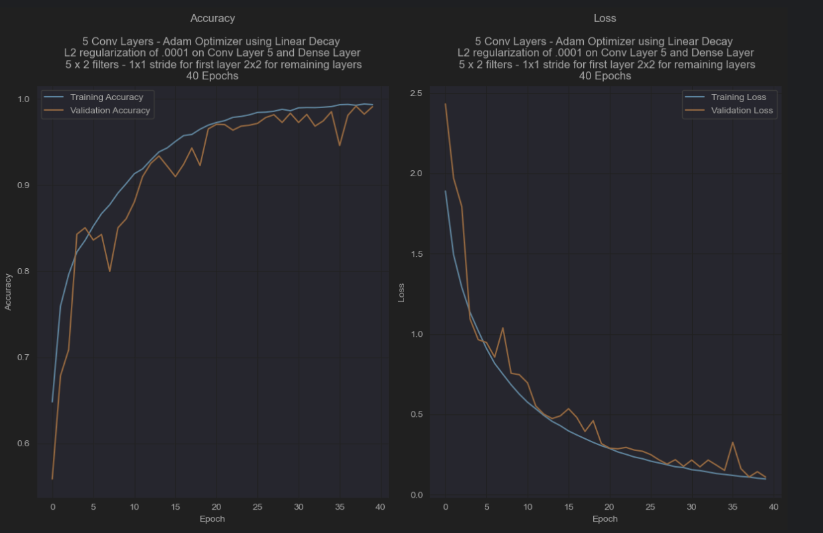
Model 3 Binary Classification Training and Test Results
Test Accuracy: .9600
Precision: .9321
Recall: .9484
F1 Score: .9642

Slide 24
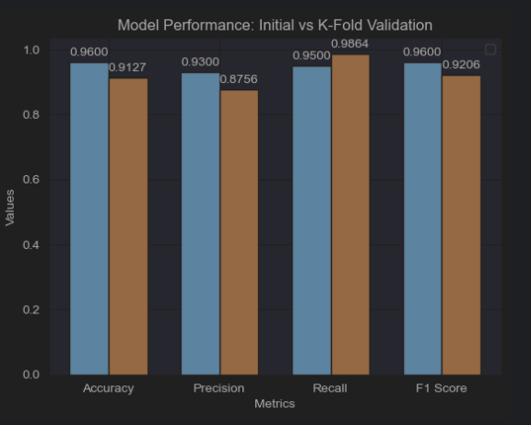
Model 3 K-Fold Cross Validation Results
K-fold validation is a statistical technique that divides a dataset into multiple subsets, using each in turn for testing a model trained on the remaining data to ensure generalized evaluation of its performance.
Average Test Accuracy: .9127
Average Precision: .8756
Average Recall: .9864
Average F1 Score: 0.9206

Slide 25
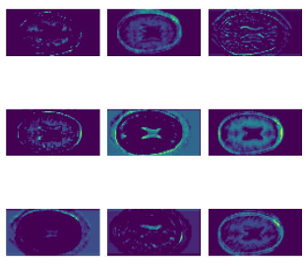
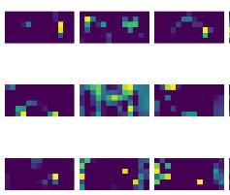
Model 1 Feature Maps Layer 1 and 3 Non-Demented

Slide 26
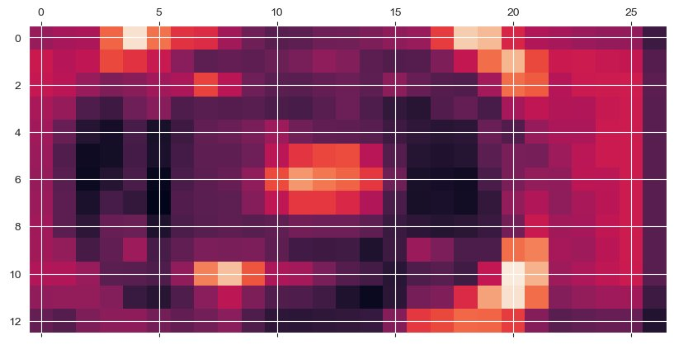
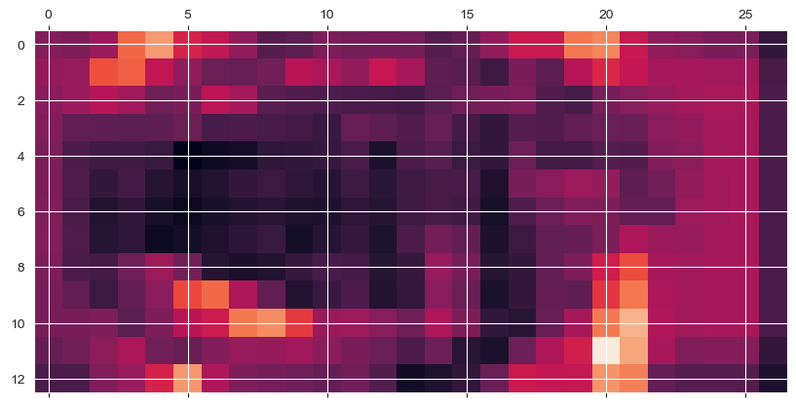
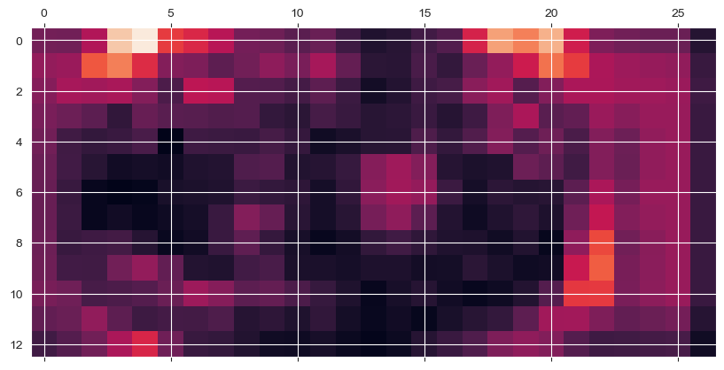
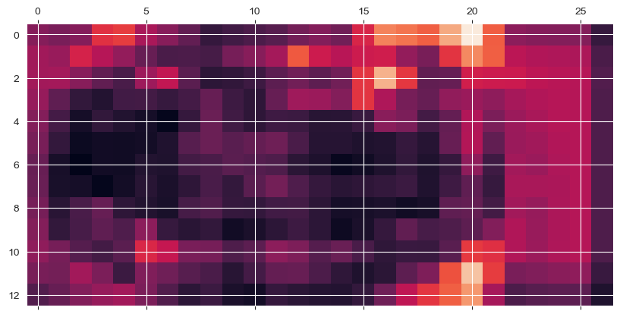
Model 1 Heat Map Layer 3
Non-Demented
Very Mild-Demented
Mild-Demented
Moderate Demented

Slide 27
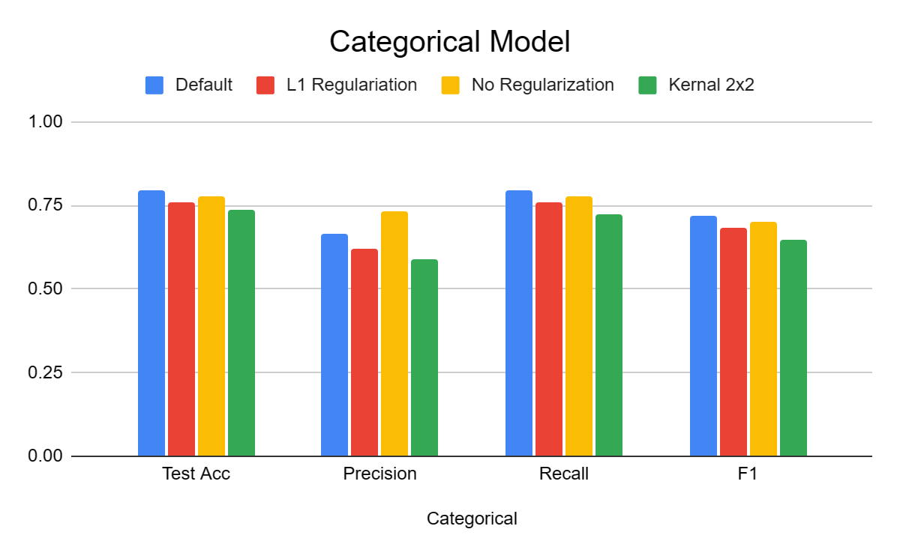
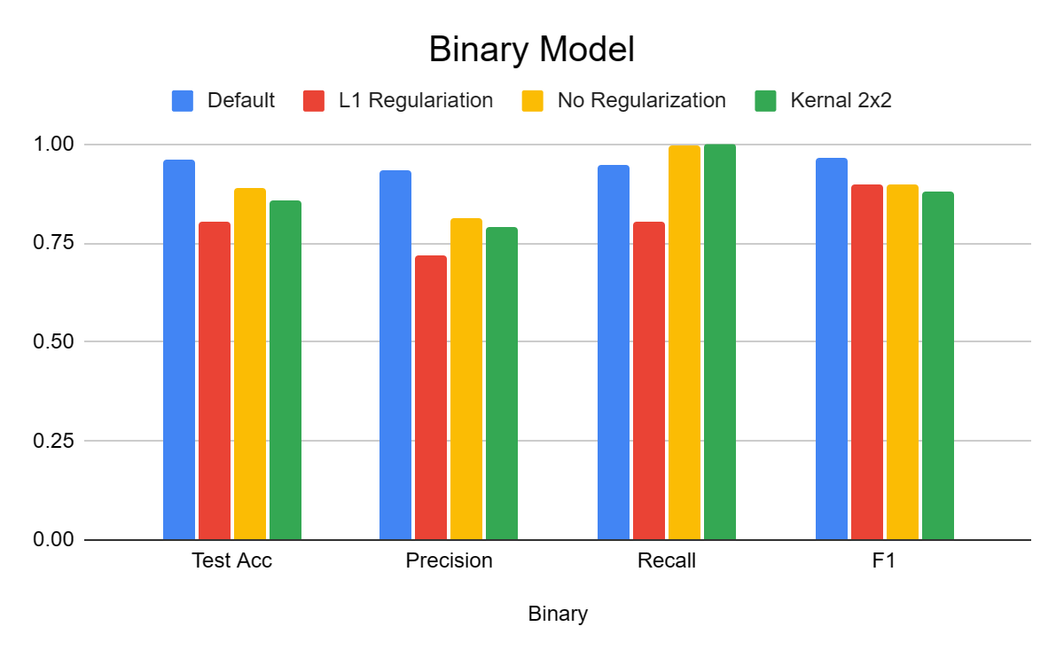
Results
Categorical | Default | L1 | No Reg | Kernal 2x2
Test Acc | 0.7934 | 0.7607 | 0.7772 | 0.7364
Precision | 0.6661 | 0.6226 | 0.7343 | 0.5873
Recall | 0.7934 | 0.7607 | 0.7772 | 0.7226
F1 | 0.7171 | 0.6832 | 0.6994 | 0.6462
Binary Model | Default | L1 | No Reg | Kernal 2x2
Test Acc | 0.9600 | .8050 | .8890. | .8590
Precision | 0.9321 | .7195 | .8123 | .7885
Recall | 0.9484 | .8050 | .9989 | 1
F1 | 0.9642 | .8369 | .8960 | .8817
EfficientNetB0 | Default
Test Acc | 0.7934
Precision | 0.6661
Recall | 0.7934
F1 | 0.7171

